Slide 1


MENS: a categorical model for
Cognition up to Phenomenal Consciousness
Andrée C. EHRESMANN*
(in collaboration with Jean-Paul Vanbremeersch)
*Université de Picardie Jules Verne, LAMFA
ehres@u-picardie.fr
https://ehres.pagesperso-orange.fr
https://vbm-ehr.pagesperso-orange.fr
« Category Theory for Consciousness Science Workshop, Oxford, April 2023
Notes:
1

Slide 2
ON THE GENESIS OF THE MODEL MENS
First, I want to thank the organizers for their invitation to this Workshop whose subject is particularly interesting for me.
My aim is to explain how the MENS model (already presented in the 2021 MCS Seminar) has been developed with Jean-Paul Vanbremeersch on a long period (since the 1980’s), making it one of the first consciousness models based on category theory.
Initially, JP and I had no formation in Neuroscience. JP was a physician, interested in problems of emergence and complexity. I was a mathematician working in Analysis and with different publications using Category Theory, such as my Paris PhD (1962) and several papers with Charles Ehresmann (my late husband). With Charles we shared the idea that:
  “a category theory approach could open a wealth of possibilities to the understanding of complex processes of any kind”. (C. Ehresmann, 1966.)
Our work with JP began later, when he suggested to apply this idea to problems of emergence, complexity and cognition, leading to our “Memory Evolutive Systems” and the MENS model..

Slide 3
OUTLINE
4 parts corresponding to 4 successive periods
Hierarchical Evolutive Systems
A categorical model for evolutionary “complex” systems
(such as bio-socio or cognitive systems)
Degeneracy / Multiplicity Principle
Multifaceted components and multipart morphisms.
Complexity and Emergence Theorems.
Development of a Memory.
III. Construction of MENS
The hierarchy of simple or multifaceted cat(egory)-neurons.
Activation and neural realizations of a cat-neuron
MENS as a MES
IV. Archetypal Core at the basis of consciousness
The Macro-landscape ML
Phenomenal consciousness: Retrospection and Prospection

Slide 4
PART I
HIERARCHICAL EVOLUTIVE SYSTEMS

Slide 5
HOW TO MODEL COMPLEX ‘NATURAL’ SYSTEMS?
Part I introduces the notion of a Hierarchical Evolutive System (HES) as a categorical model for evolutionary ‘complex’ systems such as bio-socio or cognitive systems.
“Complex” systems have the following properties :
They are evolutionary systems defined on their lifetime.
They have a tangled hierarchy of components varying in time.
The change of state consists in Thom’s ‘standard structural changes’, as suppression of components, or formation of new ones by ‘combination’ of a pattern of existing ones, e.g. to extend the memory.
They are self-organized multi-agent systems, each “agent” possessing its own temporality and logic.
To model properties (i) to (iii), we introduced new categorical notions :
Evolutive Systems (ES) for modeling the dynamic;
Hierarchical categories;
Complexification Process of a category to model ‘standard’ structural changes.
These results are indicated in a 1986 Note to Acd Sc. (presented by Jean-Pierre
Changeux) and developed in a 1987 paper in “Bull. Math. Biology”. 49.

Slide 6
EVOLUTIVE systEM
K_{t’}
Evolutive System K
It consists of :
an interval T of R;
For each t є T, a configur-ation category K_{t}
For t < t', a transition functor K(t,t') from a sub-category K_{tt'} of K_{t} to K_{t'}; these data defining a functor
K: T° → ParCat.
K_{t}
transition
K_{s}
N
N_{I'}
N'
°
°
°
I
t
t'
T
Component N' of K = maximal family of objects N'_{r} of K_{t} related by transitions. Links between components are defined similarly.
For I = ]t, t'[, let K_{I} be the category whose objects N_{I} are restrictions to I of the components N whose support contains I; the, morphisms are similarly defined from links.
Proposition. The categories K_{I} form a sheaf of categories for the topology of T.

Slide 7
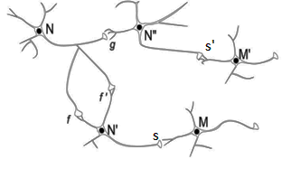
EXAMPLE: NEUR, THE ES OF NEURONS
Graph of neurons at an instant t:
Vertices 'are' the states N_{t} of the neurons N existing at t (with their rate of spiking around t). An arrow models a synapse f, with its prop-agation delay and its strength around t.
The category of paths of this graph is called the category Neur_{t} of neurons at t.
The neural system is modeled by tje Evolutive System NEUR:
(i) The configuration category at t is the category Neur_{t} of neurons at t;
(ii) The transition from t to t' maps the state of a neuron at t to its new state at t' if the neuron still exists ; and the same for synaptic paths.
(iii) The components model the neurons, and their links the synaptic paths. Such a link can be active or not at t.

Slide 8
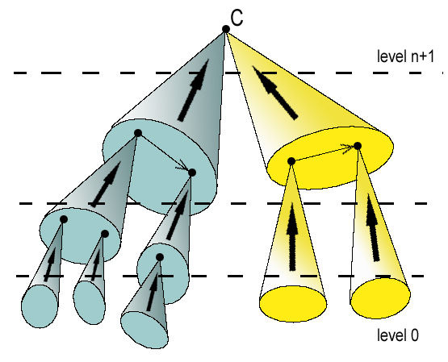


HIERARCHICAL CATEGORY and HES
Definition. A category K is hierarchical if its objects are distributed into different complexity levels (from 0 to m) so that an object C of level n+1 is the colimit of at least one diagram to K whose objects are of levels ≤ n.
level n+1
P
level n
It follows that each object C admits at least one ramification down to level 0 (whose base is a set of diagrams of level 0).
level 0
The complexity order of C is the smallest length of such a ramification.
Pure reductionism would mean that all complexity orders are 0 or 1.
HES = ES whose configuration categories are hierarchical.
The Kolmogorov-Chaitin complexity of a string is the length of the shortest program that computes or outputs x, where the program is run on some fixed reference universal computer.

Slide 9
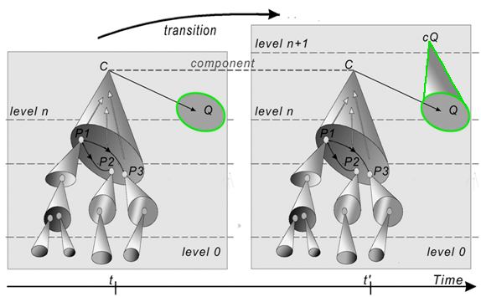
COMPLEXIFICATION PROCESS -→ ES TRANSFORMED INTO HES
This process models standard changes over time such as suppression of components and combination of some patterns without a colimit by adjonction of colimits to them. *
Simple Example: Let H_{t} be a category (hierarchical or not), S a sub-graph of it and Q a diagram to H_{t} without a colimit in it.
THEOREM. The Complexification of H_{t} for the data (S, Q) is the universal solution to the problem: finding a functor X: H_{t}\S → H_{t’} such that X(Q) admits a colimit in H_{t’}. It can be explicitly constructed
X
* It is in relation to relative completion processes studied in sketch theory (A. Bastiani-Ehresmann & C.Ehresmann, 1972).
S

Slide 10
PART II
DEGENERACY / MULTIPLICITY PRINCIPLE
COMPLEXITY AND EMERGENCETHEOREMS

Slide 11
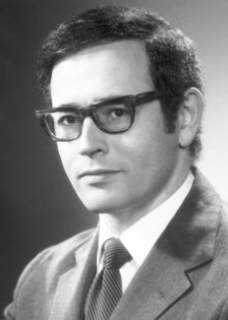
DEGENERACY OF THE NEURAL CODE
The results recalled in Part I were obtained before we knew Gerald Edelman's book “The Remembered Present“ (1989).
This book had a deep influence on our later works, and some of the concepts in this section II provide a categorical translation of Edelman’s ones. In particular our Multiplicity Principle translates his Degeneracy of the neural code (looked at in the opposite direction), and it modified our construction and meaning of MENS by introducing the notion of multifaceted mental objects.
Let us recall what Edelman means by the
degeneracy of the neural code :
"More than one combination of neuronal groups can yield a particular output, and a given single group can participate in more than one kind of signaling function. " (Edelman, 1989, p. 50).

Slide 12
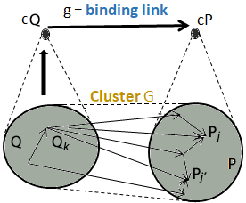
THE CATEGORY OF CLUSTERS. DEGENERACY
Definition. Given 2 diagrams Q and P to a category K a cluster G from Q to P is a maximal set of morphisms from each Q_{k} to a zig-zag of P_{i}'s, correlated by morphisms in Q.
Proposition. 1. If Q and P have colimits cQ and cP, a cluster G from Q to P binds into a unique g: cQ -> cP making the diagram commutative.
2 The clusters between small diagrams to K are the morphisms of a category having these diagrams for objects. This category is isomorphic to the cocompletion Ind_{K} of K.
Let K be a (hierarchical or not) category; In K, the degeneracy property is a kind of flexible redundancy which can be translated by saying that more than one diagram to K could have the same colimit (or ‘output’) C though there is no cluster between two of them binding into the identity of C.

Slide 13
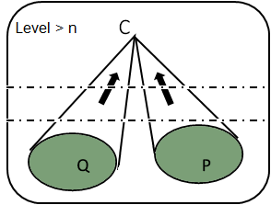
THE MULTIPLICITY PRONCIPLE (MP)
Let K be a category. Rather than speaking of ‘degeneracy’, we prefer to look at the situation upside down and define the Multiplicity Principle (MP) in K.
Definition. Two diagrams P and Q to K satisfy the MP if they have the same (virtual) colimit C and if there is no cluster beiween P and Q binding into the identity of C. Then C is called a multifaceted object of K.
If K is now hierarchical, we say that C is n-multifaceted if moreover P and Q take their values in levels ≤ n.
Degeneracy in NEUR implies that some mental objects are multifaceted.

Slide 14
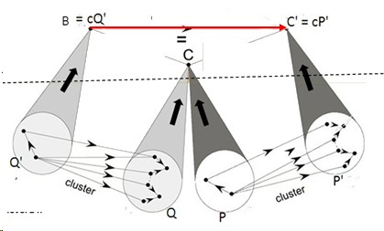
MP => EMERGENCE OF MULTIPART LINKS
multipart link g'g
Let K be a (hierarchical or not) category. If P and Q are diagrams to K which satisfy MP the bindings g and g’ of the clusters G and G' must have a composite g'g from B to C'. It is called a multipart link from B to C.
binding g
K_{n+1}
binding g'
K_{n}
If K is hierarchical and if C is an n-multifaceted object of level > n the multipart link
gg’ B → C’ is only 'emergent’ at this level since it is not 'physically' observable’ via morphisms connecting objects of Q' and P'. In fact, it depends on the 'global' structure of K which 'imposes' that Q and P have the same colimit C in K.
Here the passage from K_{n} to the higher level could be an example of a Complexification Process just adding colimits to both P’ and Q’.

Slide 15
HES SATISFYING MP
Let K be a HES. We say that it satisfies MP if it admits n-multifaceted components of each level n > 0. Such components give flexible redundancy to the system since they have a multiple identity and can operate under their different facets.
COMPLEXITY THEOREM. MP is a necessary condition for the existence in K of components of complexity order > 1.
Otherwise, we have Pure Reductionism.
EMERGENCE THEOREM. If MP is satisfied, and only in this case, a complexification process can lead to the formation of multifaceted components of increasing complexity orders and to the emergence of multipart links.
➔ Emergentist Reductionism (in the sense of Mario Bunge).
COROLLARY. MP is at the root of the development of a robust and flexible memory: it is a sub-system of K with components of increasing complexity orders called records.

Slide 16
PART III
MENS, THE MES OF CAT-NEURONS
TO MODEL MENTAL OBJECTS

Slide 17
PROPERTIES OF MENS
MENS (for Memory Evolutive Neural System) is a ‘dynamic model’ of a neuro-cognitive-mental system. We introduced it in 2002 under the name of “MES of neurons”. It proposes a common frame to study neuronal and mental processes up to the development of higher order cognitive processes, at different levels up to consciousness.
MENS is a HES having the ES of neurons NEUR as its sub-ES of level 0. Its objects of higher levels are 'conceptual' objects, called category-neurons (or cat-neurons) constructed from NEUR by successive complexification processes. They model more and more complex mental objects by activation of the colimit cP = cP' of corresponding synchronous assemblies of cat-neurons P, P'.
MENS is also a MES, meaning that it has a multi-agent dynamic which helps developing a flexible and robust memory. MEM. This memory has a higher level, called the Archetypal Core which acts as an engine for developing higher cognitive processes and consciousness.

Slide 18
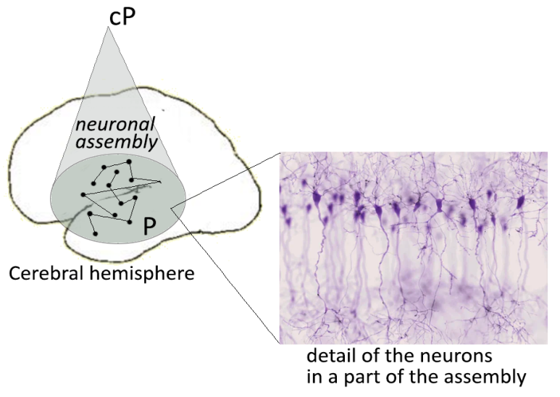
CAT-NEURONS TO MODEL MENTAL OBJECTS
Hebb (1949): "Any frequently repeated, particular stimulation will lead to the slow development of a synchronous cell-assembly" <…> capable of acting briefly as a close system ".
And he attributes their formation to the Hebb rule for synaptic plasticity.
Such synchronous cell assemblies play an essential role in the formation of mental objects. For Changeux: « L'objet mental est identifié à l'état physique <…> créé par l'entrée en activité d'une large population ou «assemblée» de neurones ».
In MENS we model the assembly (also called neural pattern) by a diagram P to a category Neur_{t} and the mental object by activation of:
the neuron colimit of P in this category when it may exist;
otherwise, the colimit cP associated to P in an adequate complexification of Neur_{t} ; then cP is called a cat-neuron of level 1.
The construction is iterated for obtaining an “algebra of mental objects“ (Changeux, 1983) modeled by cat-neurons of increasing levels.

Slide 19
HIGHER LEVELS CAT-NEURONS
The cat-neurons of level 1 constructed above are the objects of level 1 of MENS. They can be simple or multifaceted. The morphisms between them at a time t are generated by simple links binding neural clusters and by multipart links.
The full sub-category of MENS_{t} with levels 0 and 1 can also be defined as the complexification of Neur_{t} to add colimits to synchronous neural patterns with no colimit in Neur. The process allows to extend synaptic propagation delays to its morphisms.
By induction, we construct cat-neurons of level n+1 by forming a similar complexification of the full sub-system of Mens_{t} with levels 0 to n, to add colimits to synchronous (or Izhikevich polychronous) patterns whithout a colimit in it.
Any level cat-neuron cP characterizes the mental object that the different patterns P that it binds, have in common. If P lasts long enough, cP extends into a dynamic multifaceted record of P.
A is an example of a multifaceted cat-neuron of level 2 obtained as the colimit of both patterns P and R of level 1 cat-neurons.

Slide 20
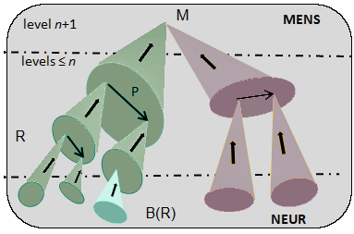
ACTIVATION OF A CAT-NEURON
A cat-neuron M of level n+1 admits at least one ramification R down to the level 0, that is NEUR. The set B(R) of its 'final’ (syn-chronous) neural patterns is called the neural base of R; it represents a physical (neuronal) realizability of M (Kim, 1998).
If M is multifaceted, it will have several such physical realizabilities.
With J. Gomez-Ramirez (2015) we have shown how this multiplicity makes possible to define a neuro-phenomenology (cf. Varela, 1996) since it means there is no 1-1 correspondance between physical/mental.
Activation of M means activation of the neural base of one of its ramifications R. Activation delay of M via R = maximum of the propagation delays of the canonical links of R from a neuron of B(R) to M. It follows that the information collected by M at t may concern events which occurred much earlier.

Slide 21
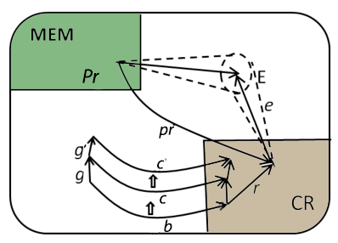
MENS AS A MULTI-AGENT SYSTEM
MENS is self-organized as a multi-agent system, via a net of sub-systems, called co-regulators, based on specialized brain modules. They modulate the dynamics through their competitive interactions.
Each CR has a hybrid dynamic:
It acts stepwise, at its own rhythm with a differential access to MEM, e.g. to recall the admissible procedures Pr corresponding to its function.
During each step it forms its actual landscape consisting of the active links which process information to CR, selects an admissible procedure Pr and sends its commands to effectors E. (This step can be modeled by PDE.)
The landscape of CR is the ES with curved
arrows for components.
The commands sent by different CRs at a given time t can be conflicting, and must be harmonized, with risk of a fracture for a CR whose commands are not realized.

Slide 22
PART IV
ARCHETYPAL CORE
AT THE BASIS OF CONSCIOUNESS

Slide 23
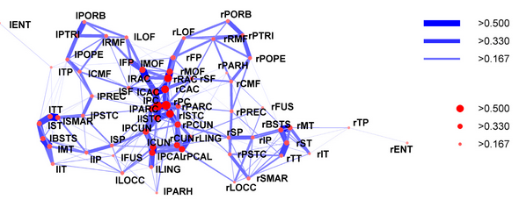
THE NEURAL BASIS OF THE ARCHETYPAL CORE
In 2008, Hagmann & al. have found an integrative part of the human brain which they call its Structural Core. They write:
  " Our data provide evidence for the existence of a structural core in human cerebral cortex. This complex of densely connected regions in posterior medial cortex is both spatially and topologically central within the brain. Its anatomical correspondence with regions of high metabolic activity and with some elements of the human default network suggests that the core may be an important structural basis for shaping large-scale brain dynamics. "
  In MENS it is modeled by a sub-ES of NEUR.

Slide 24
ARCHETYPAL CORE AC
.
AC
Development over time of the Archetypal Core AC, a higher sub-ES of the memory MEM, based on the Structural Core. It has for components multifaceted records of higher complexity orders, with many ramifications; they model often recalled significant mem-ories of various modalities.
CR_{i}
α
A
f
fu
u
AC develops strong and fast links (thanks to Hebb rule) which form archetypal loops self-maintaining their activation for a long time and resonating to lower levels via the unfolding of ramifications, thus activating a large domain of MENS.
Intentional CRs. Higher co-regulators CR_{i} based on Crick's "conscious units" (in the associative cortex) and directly connected to AC constitute, with the binding or multipart links between them, act as a macro-co-regulator.
Notes:
24

Slide 25
MACRO-LANDSCAPE
Cs Agents
MENS
AC
CR₁
CR₂
A
ML
P
Q
NEUR
Activation of part of AC diffuses through self-maintained archetypal loops.
It propagates to a decomposition P of some A, then to another decomposition Q of A, and down a ramification.
Transmitted back to intentional CR_{i} , it allows the formation of a macro- landscape ML uniting and extending spatially and temporally the landscapes of the CR_{i} . Cp to the Global Workspace.of Baars

Slide 26
MACRO-LANDSCAPE ACTING AS A MENTAL SPACE
Cs Agents
MENS
AC
CR₁
CR₂
A
ML
P
Q
NEUR
The intentional CRs constitute a "conscious agent-network”.
An arousing event leads to the activation of part of the cortex Structural Core. Archetypal objects A with their neural base of a ramification in this part are activated; their activation diffuses into AC thus starting the formation of a new macro-landscape ML.

Slide 27
MACRO-LANDSCAPE ACTING AS A MENTAL SPACE
Cs Agents
MENS
AC
CR₁
CR₂
A
ML
P
Q
NEUR
ML has a longer timeline than the landscapes of the CR_{i} since AC acts as a motor in its activation. Higher cognitive processes require an iteration of the following intertwining processes:
(i) Propagation of the activation through loops in AC, then unfolding of ramifications;
(ii) Sharing of information by the CR_{i}’s;
(iii) Recall of past or/and lower level ‘events’ by unfolding ramifications (compare to abduction).

Slide 28
MACRO-LANDSCAPE ACTING AS A MENTAL SPACE
Cs Agents
MENS
AC
CR₁
CR₂
A
ML
P
Q
NEUR
ML acts as a ‘mental space’ in which are integrated processes of different temporality and complexity. Some are conscious processes; others are 'non-conscious' (e.g., instinctive or perceptive behaviours, emotions and affects, reflexes), thus allowing ML to support embodied cognition; still others relate to phenomenal data.

Slide 29
CONSCIOUS PROCESSES
Cs Agents
An unexpected or striking event S activates part of AC
MENS
AC
CR₁
CR₂
===> formation of a long term macro-landscape ML, in which conscious processes develop by integration of time via:
A
P
Q
NEUR
1. Retrospection: analysis of the situation and recall of near past for "making sense" of S (by abduction).
S
Attention ↑
AC is activated
2. Prospection: search of "scenarios" by iteratively constructing ‘virtual’ landscapes ("mental spaces") in ML in which sequences of procedures are tried, by evaluation of the corresponding complexifications.
Activated domain ↑
Intentional CRs cooperate
Scenarios
Lower CR's
ML
Retrospection
Prospection

Slide 30
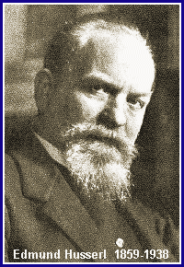

REMARKS ON THE MACRO-LANDSCAPE
The retrospection and prospection processes developped in ML are to be compared to the retention and protention processes considered by Husserl :
"Il y a dans le présent une rétention du passé (rétention primaire si c’est un passé immédiat, rétention secondaire si c’est un souvenir plus lointain) et une protention du futur (de ce qui va immédiatement arriver). "
===> Successive global spaces overlap (unity of Self).
The macro-landscape can be compared to the "Global Workspace", already proposed by Baars in 1997, "closely related to conscious experience, though not identical to it". He illustrates it by the "Theater of Consciousness" metaphor.

Slide 31
CONCLUSION
MIND | MENS | BRAIN
Simple Mental Object | (Cat)-neuron level 0 Cat-neuron of level 1 | Neuron Class of (equivalent) synchronous neural assemblies
Algebra of mental objects | Cat-neuron of level n | Class of synchronous neural hyper-assemblies (= assembly^{n})
Emerging Properties | Multifaceted objects Multipart links | Degeneracy of the neural code
Self | Archetypal Core | Structural core of the brain (Hagman et aL)
Conscious processes | Global Lan6dscape Retro- and pros pection | Structural core of the brain Consciousness loop (Edelman)
MENS proposes a theory of mind, in which a hierarchy of mental objects and processes emerges from the functioning of the brain, through the iterative binding of neuronal assemblies. We show that the degeneracy property is the characteristic which makes this emergence possible and explains how it allows the development of a flexible memory, with a higher central part, the Archetypal Core. AC is at the basis of the self and of the formation of higher cognition up to consciousness, seen as the integration of past and future. It is mainly qualitative, though some quantification should be possible using the propagation delays and strengths of links in MENS.

Slide 32
FOR MORE INFORMATION
Memory Evolutive Systems: Hierarchy, Emergence, Cognition, Elsevier, 2007.
MENS, a mathematical model for cognitive systems, JMT 0-2, 2009.
MENS, an info-computational model for (neuro-)cognitive systems up to creativity, Entropy 14, 2012, 1703-1716 (Open Access).
Conciliating neuroscience and phenomenology via category theory (with J. Gomez-Ramirez), Progress in Biophysics & Molecular Biology (JPMB), Vol. 119, 2, Elsevier, 2015, 340-359.
MES: a mathematical model for the revival of Natural Philosophy (with J.-P. Vanbremeersch), Philosophies, MDPI 2019, 4, 9;
The following internet sites contain a large number of our papers:
https://ehres.pagesperso-orange.fr
https://vbm-ehr.pagesperso-orange.fr
THANKS

