Slide 1
DESIGNING RICHER HUMAN-MACHINE INTERACTIONS FOR COMPLEX ORGANISATIONS:
A CATEGORY-THEORETIC APPROACH WITH MEMORY EVOLUTIVE SYSTEMS
Andrée EHRESMANN, Mathias BEJEAN and Jean-Paul VANBREMEERSCH
Notes:
by

Slide 3
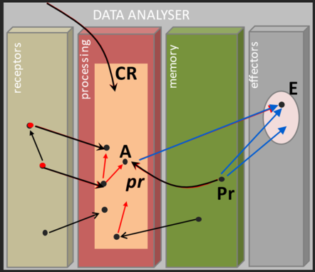
Aim: To enrich H-M-interactions in a complex organisation S, supported by a human group G.
At this end, we propose a conceptual mathematical framework (based on categorical constructions) by which G models in S a multi-level artificial cognitive system called a “Data-Analyser”. This DA, not only learns, processes and stores data but may also generate by itself new strategies (a challenge in AI).

Slide 4
Part 1 . Construction of a DA in a complex organisation S in using the MES frame
Part 2. Particular case where S is a care-house for vulnerable persons. This part will be presented by Dr. Vanbremeersch who introduced the idea of such a DA in the care-house of which he was the coordinating physician.

Slide 5
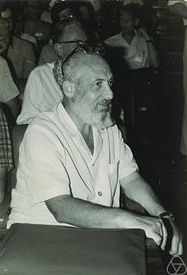
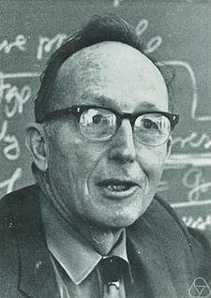
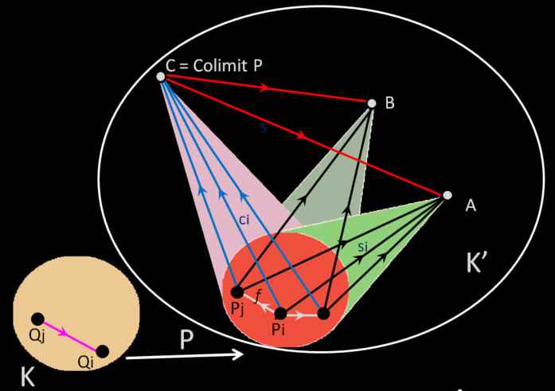
CATEGORICAL CONSTRUCTIONS
The notion of a category has been introduced by Eilenberg and Mac Lane in 1945. Since then the Theory of Categories has much developed and can be found in many books.
Here we suppose already known the main categorical notions, for example the notion of the limit or colimit of a functor P
Eilenberg
Mac Lane
A functor P: K -> K' admits a colimit C in K' if it exists a cône called colimP in K' with base P and top C such that any other cone in K’ with base P and top A factorizes via colimP by a unique morphism from C to A .
C can be thought as a kind of "aggregate" in K' of the objects P(k) for k object of K taking into account of their morphisms in K.

Slide 6
MEMORY EVOLUTIVE SYSTEMS (MES)
For enriching H-M-I in a complex organisation S, supported by a human group G, we will show how to construct a DA, using successive constructions of Category Theory which we’ll quickly describe
This will be done using the Memory Evolutive System (MES) theory (A. Ehresmann and J.-P. Vanbremeersch 1997-2007). The MES propose a Category-Theoretic approach for studying complex, evolutive, hierarchical and multi-agents, systems
A system S is evolutive if there is an interval T of R – its life time, such that, for each t in T, there is a category S(t) called its t-configuration and, for t’ > t in T a partial functor transition from S(t) to S(t’) which is a complexification of S(t) for a specific procedure on S(t); this defining a functor to the category Par(Cat).

Slide 7
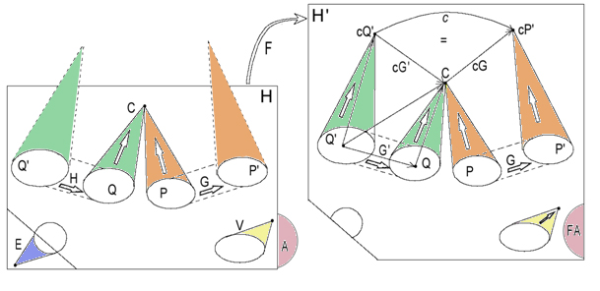
COMPLEXIFICATION PROCESS : The complexification of a category H for a procedure Pr given on H is an important process which will be iteratively used to construct the Data Analyser DA in a complex organisation
Q'
P'
COMPLEXIFICATION THEOREM : We consider a category H and a ‘procedure’ Pr on H with the following objectives: to suppress the cone E, to add colimits cP' and cQ' to the functors P' and Q' in H. The complexification H' for Pr 'optimally' adds the colimit cones of bases Q' and P', the simple links cG and cG' binding the clusters G and G',the complex link c: cQ'-> cP' which is their composite, whence the functor F: H -> H'.

Slide 8
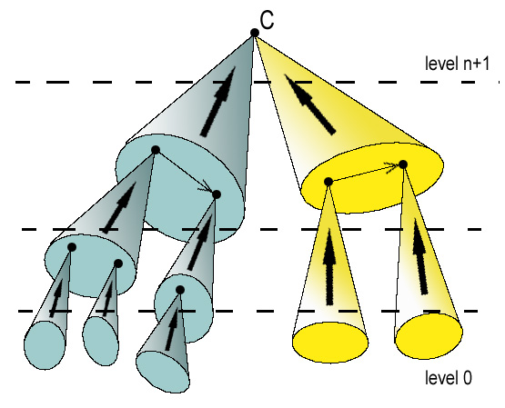
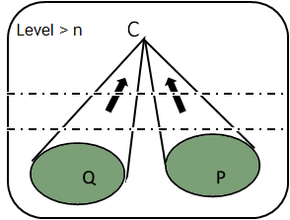
HIERARCHICAL CATEGORY
HIERARCHICAL CATEGORY and HES
Definition. A category is hierarchical if its objects are distributed into different complexity levels (from 0 to m) so that an object C of level n+1 is the colimit of at least one pattern of connected objects of levels ≤ n.
It follows that each object C admits at least one ramification down to level 0 (whose base is a set of patterns of level 0).
The complexity order of C is the smallest length of such a ramification.
Pure reductionism would mean that all complexity orders are 0 or 1.
THE MULTIPLICITY PRINCIPLE (MP)
Definition. If K is hierarchical, two diagrams P and Q to K satisfy the MP if they have the same colimit C and if there is no cluster between P and Q binding into the identity of C. Then C is called a multifaceted object of K.
The multiplicity principle corresponds to Edelman's Degeneracy principle .

Slide 9
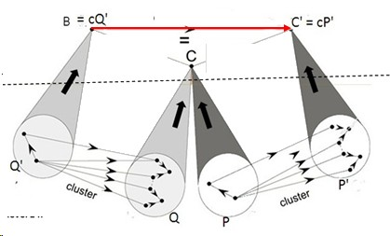
MP IMPLIES THE EMERGENCE OF MULTIPART LINKS
multipart link g'g
Let K be a (hierarchical or not) category. If P and Q are functors to K which satisfy MP the bindings g and g’ of the clusters G and G' must have a composite g'g from B to C'. It is called a multipart link.
binding g
K_{n+1}
binding g'
K_{n}
If K is hierarchical and if C is an n-multifaceted object of level > n the multipart link gg’: B → C’ is only 'emergent’ at this level since it is not 'physically' observable’ via morphisms connecting objects of Q' and P'.
In fact it depends on the 'global' structure of K which 'imposes' that Q and P have the same colimit C in K.

Slide 10
MES SATISFYING MP
Let S be a MES. We say that it satisfies MP if it admits n-multifaceted components of each level n > 0. Such components give flexible redundancy to the system since they have a multiple identity and can operate under their different facets.
COMPLEXITY THEOREM. MP is a necessary condition for the existence in S of components of complexity order > 1.
Otherwise, we have Pure Reductionism.
EMERGENCE THEOREM. If MP is satisfied, and only in this case, a complexification process can lead to the formation of multifaceted components of increasing complexity orders and to the emergence of multipart links.
➔ Emergentist Reductionism (in the sense of Mario Bunge).
COROLLARY. MP is at the root of the development of a robust and flexible memory: it is a sub-system MEM of S with components of increasing complexity orders, called records. If S has a DA, the memory unit of DA is included in MEM.

Slide 11
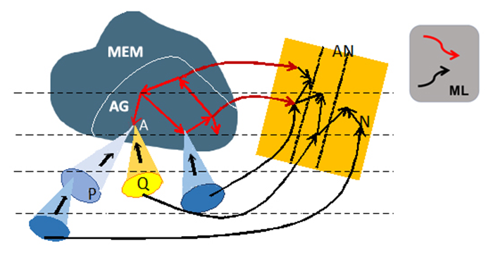
IMPROVING DECISION-MAKING IN A MES S
When G and DA act together as coregulators of the MES S in meetings of S, DA acquires a better cooperation between elements in G which allows the formation of a G-archetypal pattern AG of their shared concepts. Therefore it follows less misunderstandings in the meetings between the elements of G.

Slide 12
IMPROVING DECISION-MAKING IN A MES S
It leverages the MES’ “Emergence Theorem” which models how G and DA acting as co-regulators of S, can form a ‘macro-landscape’ through two phases: first by constructing a shared understanding of the situation (“retrospection”) and then by collaboratively searching strategies, evaluating them, and selecting one (“prospection”). This co-regulatory dynamic enhances both individual and cooperative decision-making between G and DA over time,.

Slide 14
Part 2 : Particular case where S is a care-house for vulnerable persons

Slide 15
In the case of a care establishment for vulnerable people, one of the important challenge would be the development of alerts to prevent the occurrence of epidemics within the institution.
For that the DA is being built little by little by selecting specific arrows to develop learning and else via successive complexifications of the category generated by such arrows.
The Emergence Theorem shows that, over time, this process adds objects of increasing complexity order in DA.

Slide 17
par = Patient
Receptor
rp =
Receptor
Processor
pp =
Processor
Processor
pm =
Processor
Memory
learning

Slide 18
par = Patient
Receptor
rp =
Receptor
Processor
pp =
Processor
Processor
pm =
Processor
Memory
mp =
Memory
Processor
me =
Memory
Effectors
learning
recall
action

Slide 19
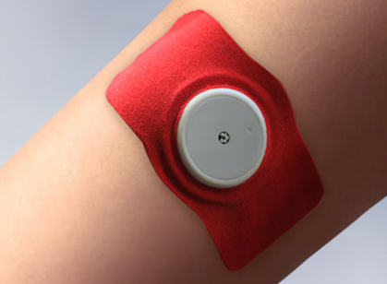
par
Learning process of the DA :
at first a biological item is automatically measured through electronics skin sensors, and received (par) by Receptors
Notes:
E

Slide 20
par
rp
pm
Learning process of the DA :
Then the processing unit (CR) receives the information via rp, and transmit information to memory via pm.

Slide 21
par
pp
rp
pm
Learning process of the DA :
Other informations are noticed by the processor through other sorts of physical or biological measures, such as renal function, arterial pressure, cardiac rythme, temperature or even paraclinic data directly indicate to receptor of the DA by care people. Those item are integrated by complexification in a colimite within the processor.

Slide 22
mM
par
pm
mm
pp
rp
pm
Learning process of the DA :
It transmits, via pm, mm, mM , the data to the memory, increasing level at each measure to upper levels of the memory obtained by complexifications adding colimits

Slide 23
mM
par
PM
mm
pp
pp
rp
pm
Learning process of the DA :
When the memory of an item is hard built, then the recalling process introduces via complexification a hierarchical upper level in processing unit.

Slide 24
mM
PM+
par
PM
mm
pp
pp
rp
Learning process of the DA :
Then through both the hierarchical complexification in Memory and Processor, the memorization has become stronger and allows a high level recalling process PM and PM+ to mM.

Slide 25
Me
mM
PM+
par
PM
mm
pp
pp
rp
pm
Learning process of the DA :
from the higher level of complexification in the memory, there are links Me to the effectors, leading to actions by the DA on the patient

Slide 26
pM++
Me
mM
PM+
par
PM
mm
pp
pp
rp
pm
Learning process of the DA :
The construction of higher and higher complexity orders of colimits allows a strong memorization of the whole process.

Slide 27
pM++
Me
par
pp
rp
Recalling process of the DA :
The purpose of the memorization by the Data Analyser, during a subsequent stimulation ‘par-rp’, will enable the system to react directly via pM++ to the effectors.

Slide 28
Therefore the Data Analyser by the Emergence Theorem, develops the complexity order of its records in the processor and the memory, upgrading the use of the DA.
It will optimise its reactivity,
increase the quality of its observations,
and the adaptation of its strategic responses.
In particular it could reduce the spread of an epidemy in the institution, and reduce the morbi-mortality.

Slide 29
Thanks for your attention

