Slide 2
A conceptual framework of Human-Machine interactions for enriched Futures Literacy
Andrée EHRESMANN
with Mathias BEJEAN and
Jean-Paul VANBREMEERSCH

Slide 3
The Futures Literacy (FL) framework
"FL is an emergent and evolving capability <… > the conscious human capability to anticipate." "By definition therefore, being Futures Literate is the capacity to identify, design, target and deploy Anticipatory Assumptions (AA). <…> to ‘use-the-future’ for specific ends in particular contexts".
Riel Miller in "Transforming the Future" (2018)
Here FL is extended to the case of a social organisation S which customizes an evolutive high-tech Data-Analyzer DA (with receptors, effectors, process-sing unit and multi-level memory) for developing rich human-machine interactions, so that S+DA together become Futures Literate and act in this way for the long term.

Slide 4
The approach: Memory Evolutive Systems
MES (Ehresmann & Vanbremeersch) give a mathematical methodology for studying complex unpredictable systems with:
(i) a hierarchy of interacting (multifaceted) components varying in time,
(ii) a self-organisation with a network of co-regulator agents,
(iii) a multi-level flexible memory developing in time.
A main result is how to model emergency of complexity and 'changes in the conditions of change'.
S is modelled by a FL-MES with a co-regulator modelling DA and a co-regulator modelling an executive group G of S which processes DA.

Slide 5
Results. Roles of DA
DA collects information of any nature, stores, analyses and classifies it.
Rich human-machine interactions allow G and DA to share knowledge and values and develop a large relational data-base. Using it, collective intelligence knowledge creation processes help design both 'repetition' AA ('colonising' the future), and 'innovative' AA (for 'novel' futures).
Through its receptors DA can detect weaker signals, allowing it: (i) to alert G; (ii) to possibly react by itself to implement already learnt 'repetition' AA, e.g. in emergencies for risk prevention; (iii) to increase explicit and even tacit communication and negotiation in G, so that DA+G acts as an efficient decision-maker, possibly capable to implement 'innovative' AA.

Slide 6
Collaborative DA+G decision-making process
(i) Formation of a pattern AG of multifaceted 'G-archetypal' records to share information and knowledge (explicit, tacit, even emotional).
(ii) Retrospection Process: AG allows constructing an extended macro-landscape of DA+G and analysing it to sense and make sense of the situation.
(iii) Prospection Process to search for adequate AAs and reach a consensus decision 'using-the-future', possibly leading to 'novel' futures.
Formation of the G-Archetypal Pattern AG
AA Scenarios
MacroLandscape
Prospection
Retrospection

Slide 7
Applications to risk prevention
1. Environmental risk prevention
A group G of members of a local environmental agency S trains a DA to help designing innovative AA for risk prevention, accounting for the complexity of the environmental changes.
2. Health-risk prevention in a care-house for fragile people
The medical team trains a DA to develop creative processes monitoring health risks thanks to an earlier recognition of weak pathological signals and their faster treatment, e.g. preventing dissemination of epidemics.

Slide 8
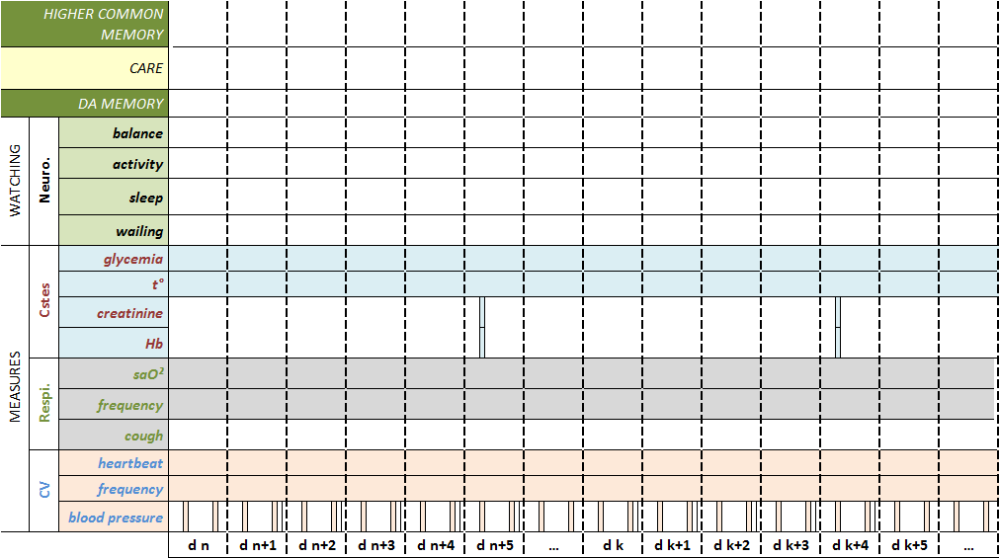
5 days
3 days
2.5 days
1 day
C1
C1
C1

Slide 9
Conclusion
Using the MES methodology we have proposed to develop an enriched FL-framework for a community equipped with a customized evolutive DA whose presence allows both: (i) faster responses to emergencies, and (ii) design of innovative AA leading to 'novel' futures.
This could help decision makers and policy makers in elaborating new ways for preventing various risks (e.g. for health or environment) for the populations they administrate, and for conceiving innovative policies.
Thank you for your attention

