Slide 1
MEMORY EVOLUTIVE SYSTEMS
and
GERIATRIC DATA ANALYSIS DESIGN
SYSTEMES EVOLUTIFS A MÉMOIRE
et
ANALYSEUR DE DONNEES EN GERIATRIE
Andrée EHRESMANN et Jean-Paul VANBREMEERSCH

Slide 2
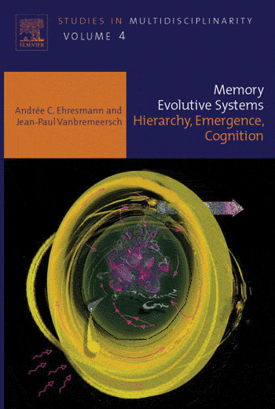
The Memory Evolutive Systems propose a mathematical methodology (based on a 'dynamic' Category Theory) for studying the evolution of 'complex' multi-level, multi-agent systems such as biological, social or (artificial) cognitive systems.
Applications
Biology: Integral Biomathics (P. Simeonov, INBIOSA). Immunology.
Cognition: model MENS with emergence of higher cognitive processes,
e.g. creativity (M. Andreatta, IRCAM).
Collective intelligence/action, Innovation and Design (D-MES, Béjean),
Anticipation and Future Studies (Poli, Miller, UNESCO).

Slide 3
THE PROBLEM
Better monitoring and prevention of geriatric risk factors in a high-risk population such as the residents of a nursing-home for elderly dependent persons (EHPAD in French).
IDEA. Design a high-tech multi-level Data Analyser DA able to:
(i) continuously collect medical and behavioural data while respecting the intimacy and comfort of the residents ;
(ii) analyse them and alert the medical team in case of problems;
(iii) cooperate with this medical team for the creation of 'Deep Learning' about the possible risks and their prevention. Example: reducing the epidemical risks.
METHOD. Use of the Memory Evolutive Systems methodology (Ehresmann & Vanbremeersch) to construct a MES incorporating both the nursing-home people and the data analyser, in which all the preceding operations can be effected.

Slide 4
The Data analyser
Two Main geriatric constraints
Principle of good-treating ('bientraitance'),
Elderly persons are not in a temporary care-home but in their residential home.
Thus avoid forced or invasive medical or para-medical explorations and respect the private character and intimacy of their housing.
➔ Need of discrete, light, permanent devices able "to be overlooked".
As much as possible and whatever be the health problems, limit painful or disturbing explorations (punction, injection, blood-pressure taken by nurses, total or partial undressing etc..)
➔ To respect the privacy and intimacy of their housing:
organize the up-keeping and if possible the medical treatments without the heavy care material used in hospitals and clinics.

Slide 5
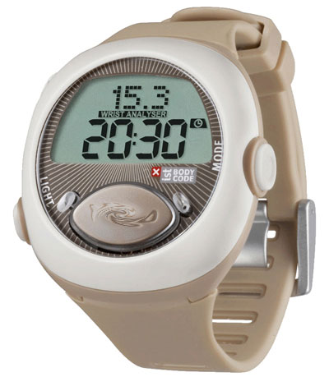
Thanks to the miniaturization of functional exploration equipment which already exist, there should be soon an explosion of such materials. For instance there already exists analysers of the general physiological activity using a mechanism of percutaneous measures.
Here is an example which is daily used. It is a watch measuring the general activity and which is wireless connected to a network of captors inside the EHPAD buildings, in the park, in the entrance/exit zones.
Data are sent to a computer terminal, where a software stores and analyses them and produces curves, possibly alarms, …
storing the quality of sleep, intense night activity, awakening periods,
signalling the risk of falls,
for elders with a severe neuro-degenerative syndrome, signalling their going out of the institution.
Huge benefits follow up, in terms of the residents, the optimisation of psychotropic medication, and so on

Slide 6
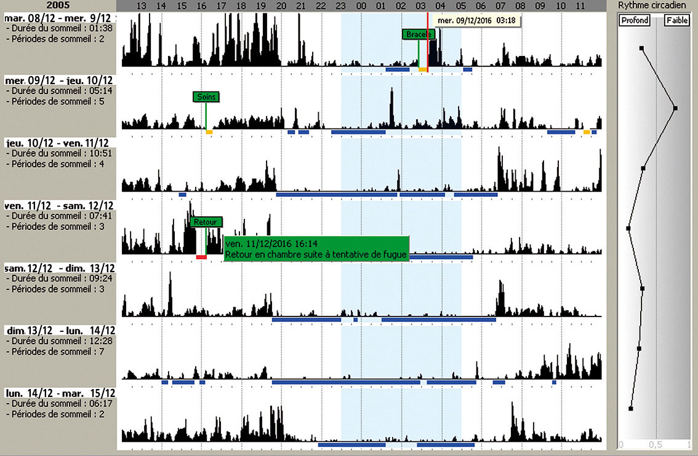
Physiological activity curves for a resident during a week

Slide 7
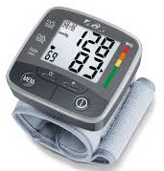
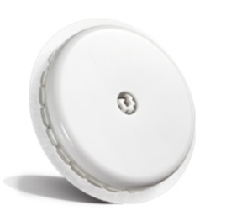
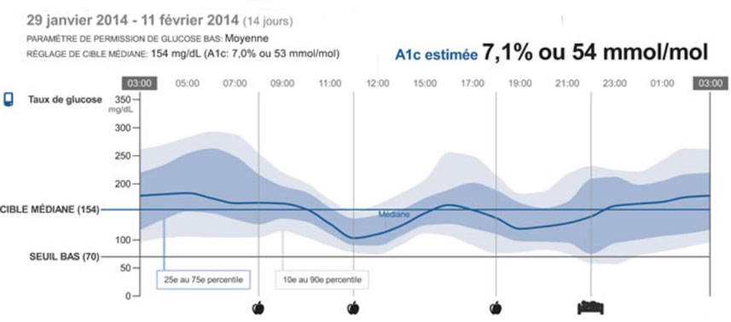
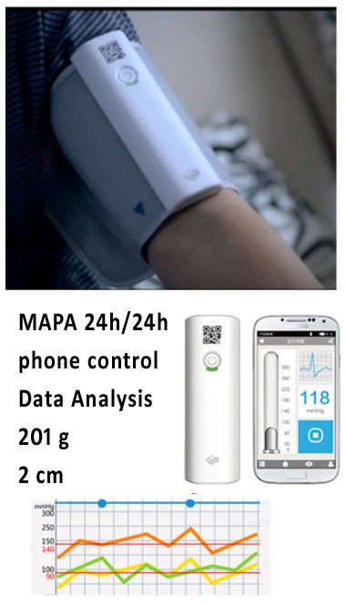
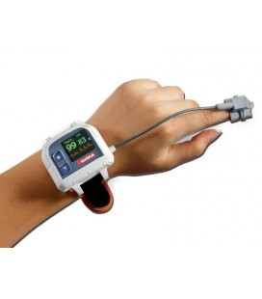
Some other already existing devices with a wireless connection
Lecteurs de glycémie percutanée en continu
MAPA
Mesure Ambulatoire de la Pression Artérielle
Capteur percutané en liaison avec analyseur de glycémie
Saturomètre O² percutanée

Slide 8
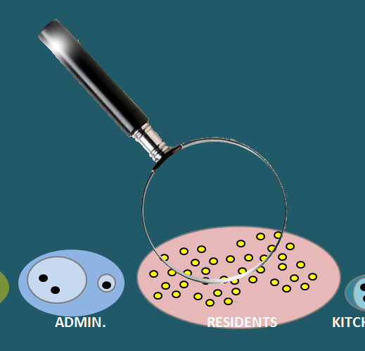
All these devices could already be integrated in a Data Analyser,
operating continuously inside the institution.
NURSING HOME FOR ELDERLY DEPENDENT PERSONS (EHPAD in french)
DATA ANALYSER
A resident
captors
AGENTS NUR. NUR. C. MED. ADMIN. RESIDENTS KITCHEN MAINT.

Slide 9
NURSING HOME FOR ELDERLY DEPENDENT PERSONS (EHPAD in french)
DATA ANALYSER
RESIDENTS
DIR.
MED.
NUR. C.
NUR.
AGENTS
D.A. receptors
D.A. processing
D.A. memory
D.A. output
Capteurs Résidents
P
AGENTS NUR. NUR. C. MED. ADMIN. RESIDENTS KITCHEN MAINT.
Résidents Captors

Slide 10
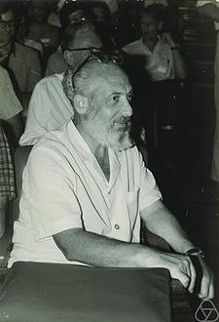
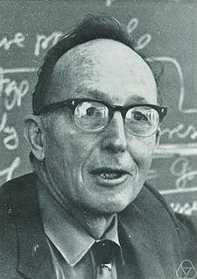
Category Theory
introduced by
in 1945
Eilenberg
Mac Lane
It is a 'relational' mathematics,
at the border between mathematics, logic and metamathematics.
It reflects the main operations of the "working mathematician"
« This theory of categories seems to be the most characteristic
unifying trend in present day Mathematics. »
(Charles Ehresmann, 1966)

Slide 11
Category Theory
introduced by
in 1945
Eilenberg
Mac Lane
Category = graph plus composition of paths,
associative and with
identities
Graph : objects
A,B,C,D,E
and arrows
between them
A
fgh
h
B
E
fg
g
C
D
gh
f

Slide 12
Evolutive System (ES)
Kt = Configuration at t Transition = partial functor
transition
K0
Kt
Kt'
Kt"
Component M'
M" t"
Component N"
N" t0
N" t
N" t'
N" t"
s' t'
s' t"
link s'
s' t0
s' t
Component N'
N' t0
N' t
N' t'
N' t"
link s
s t0
s t
s t'
s t"
Component N
N t0
N t
N t'
N t"
M t0
M t
Timeline
t0
t
t'
t"

Slide 13
Colimit of a pattern
C = Colimit P
B
s
A
ci
si
f
Pj
Qj
Pi
Qi
P= Pattern
Q

Slide 14
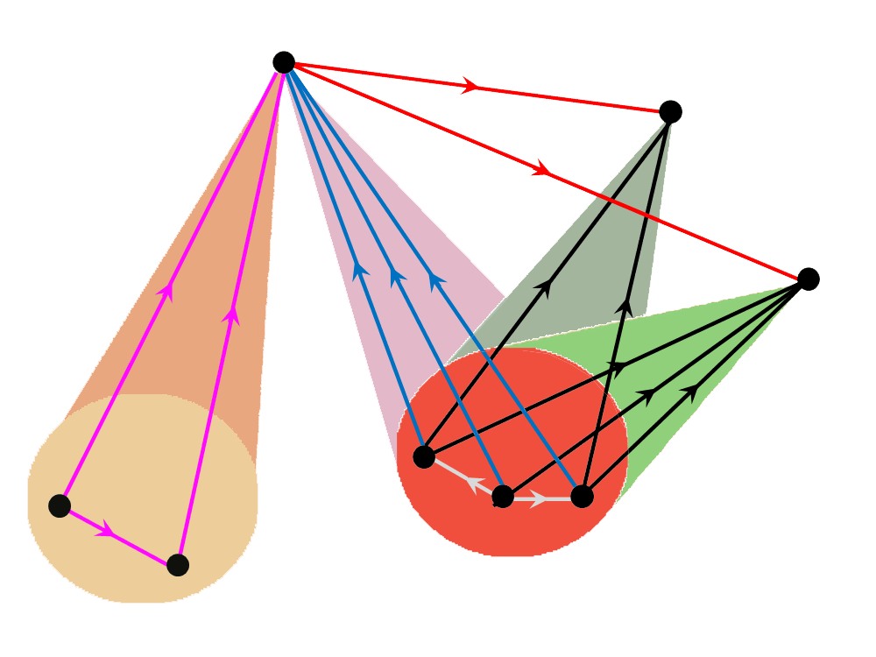
Multiplicity Principle = existence of multifaceted objects
C = multifaceted object if there exist non cluster-connected patterns
P and Q with colimit P = colimit Q = C
C = Colimite P
C = Colimit P
B
s
A
ci
si
f
Pj
Qj
Pi
Qi
P = Pattern
Q

Slide 15
Hierarchical category. Simple and complex links
Complex
M
Simple
M'
Simple
C
level n+1
ci
P'
cluster
Q'
f
Pj
Qj
Pi
level ≤ n
Qi
P = Pattern
Q

Slide 16
DATA ANALYSER
D.A. memory
D.A. processing
D.A. output
D.A. receptors
NUR. MED. RESIDENTS
Résidents Captors

Slide 17
Hierarchical Evolutive System. Complexification Process
M'
M
level n+1
C
P'
Q'
level n
Q
P
X
level 0
Ht
t
t'
t"
Time
Procedure (= semi-sketch) on a category Ht : elements X (to suppress); patterns P', Q' (to 'bind' by adding colimits).
COMPLEXIFICATION THEOREM: There is a 'universal solution' to the problem of constructing a partial functor transition from Ht to a category Ht' containing Ht\X and in which P' and Q' acquire a colimit. If Ht satisfies MP, complex links may emerge in Ht'.

Slide 18
Complexification Process. Emergence Theorem
transition
Complex link
M'
M
M'
M
level n+1
level n+1
Simple links
C
C
P'
P'
Q'
Q'
level n
Q
P
level n
Q
P
X
level 0
level 0
Ht
t
Ht'
t'
t"
Time
Procedure (= semi-sketch) on a category Ht : elements X (to suppress); patterns P', Q' (to 'bind' by adding colimits).
COMLEXIFICATION THEOREM: There is a 'universal solution' to the problem of constructing a partial functor transition from Ht to a category Ht' containing Ht\X and in which P' and Q' acquire a colimit. If Ht satisfies MP, complex links may emerge in Ht'.

Slide 19
Emergence Theorem
transition
A
level n+2
transition
Complex link
Complex link
M'
M
M'
M
M'
M
level n+1
level n+1
Simple links
level n+1
Simple links
C
C
C
P'
P'
P'
Q'
Q'
Q'
level n
Q
P
level n
Q
P
level n
Q
P
X
level 0
level 0
level 0
Ht
t
Ht'
t'
Ht"
t"
Time
EMERGENCE THEOREM. In a hierarchical Evolutive System satisfying MP, successive complexification processes may lead in time to the emergence of more and more complex components and complex links between them.
➔ Without MP pure reductionism
➔ Iterated complexification = Categorical approach to 'Deep Learning'.

Slide 20
Memory Evolutive System (MES)
A MES is a HES with supplementary properties:
1. Numerical data. A component N is a dynamical entity (= family of its successive states Nt) having various attributes which are numerical functions during its life. For example for a resident: activity, weight, temperature, … Idem for a link, among the attributes of which figure its propagation delay and its strength. A link can be active or not at t.
2. Memory. A MES has a hierarchical sub-HES Memory which develops over time to store new items which can later be recalled.
3. Multi-agent and Multi-temporality. It has a network of sub-ES, called co-regulators, acting stepwise, each with its own rhythm, function and differential access to the memory to recall the procedures related to its function. The 'global' dynamics is obtained by interactions between their 'local' dynamics. The rhythms of the co-regulators can be very different.

Slide 21
One step of a co-regulator CR
A co-regulator CR acts stepwise as a hybrid system with 2 timescales: the continuous 'clock' time of the system and its own discrete timescale delimiting its steps. A step from t to t' is divided in 3 more or less overlapping phases.
1. Observation: Formation of the landscape of CR at t. It is an ES on [t, t'] whose components are links activating at least 1 component of CR during the step.
DATA ANALYSER
receptors
processing
memory
effectors
CR
E
2. Decision: selection of an admissible procedure Pr with the help of the memory (seen via pr in the landscape). Sending of the commands of Pr to its effectors E via CR.
A
pr
pr
Pr
3. Action: the dynamic realizing Pr can often be modeled by ODE in terms of attributes. Evaluation of the results at t'. ➔ Fracture if objectives not achieved.

Slide 22
Formation of a record in the Memory by CR
At a time t a new item activates a pattern P of receptors. This pattern diffuses its activation to a pattern in the landscape of CR at t, leading to the activation of a pattern P' in CR.
receptors
processing
memory
CR
P
t
t'
t"
Time

Slide 23
Formation of a record in the Memory by CR
The activation of P' increases the strength of the links between its components (generalized Hebb rule or STDP) which can be realized by solid-state synapses (cf. Yang & al. 2013 or Boyd & al., 2017).
receptors
processing
memory
receptors
processing
memory
CR
CR
P
P'
P
P
P
t
t'
t"
Time

Slide 24
Formation of a record in the Memory by CR
The strengthening of P' leads to the formation of a colimit rec.P of P' (by a complexification process) in the memory . This rec.P can be directly activated by P (via composite links P → P' → rec.P) and it becomes the record of P.
receptors
processing
memory
receptors
processing
memory
receptors
processing
memory
rec.P
CR
CR
CR
P
P'
P
P
P
P'
P
P
t
t'
t"
Time

Slide 25
Recall of a record in the Memory
If the pattern P of receptors has already a record Rec.P, the activation of P immediately leads to the activation of its links toward this record which is so recalled.
receptors
processing
memory
rec.P
rec.P
CR
P
P'

Slide 26
Nursing Home MES
- learning
Learning

Slide 27
Nursing Home MES
- recall
- learning

Slide 28
Nursing Home MES
- recall
recall
higher learning
Recall + learning

Slide 29
Nursing Home MES
- recall
recall
higher recall
Recall + learning

Slide 30
Nursing Home MES
- recall
recall
higher recall
- mix procedure learning
Recall + learning + processing + action

Slide 31
Interplay among the co-regulators
Fracture
CR'
CR
CR procedures
Operative
procedure
Co-regulators
Interplay
The commands of the procedures of the different co-regulators to their effectors can be conflictual. Whence an 'interplay' among them, with risk of fracture for some CR. Under some particular conditions, the global operative procedure can be modeled by a hybrid dynamical system (M. Branicki, 2005).

Slide 32
Temporal constraints of a co-regulator
For a step of a co-regulator CR to be achieved in time, the following Synchronicity Laws should be respected at each step:
p(t) << d(t) << s(t), or s/p >> s/d >> 1
where
d(t) = period of CR = mean length of the 10 preceding steps,
s(t) = smallest stability span of the components of its landscape at t,
p(t) = greatest propagation delay of the components of this landscape.
Their non-respect on one step causes a fracture. If it cannot be repaired soon enough, it becomes a dyschrony, which may lead to a long-term desynchronization; later the period can be resynchronized.
Dyschronies are a main cause of fractures which can 'jump' between levels.

Slide 33
Dialectics between heterogeneous co-regulators
Resynchronization
Dyschronie
Desynchronization
System dysfunction,
step of CRn interrupted
Temporal
changes
CRn+k
CRn
fracture
Dyschronie
Desynchronization
Resynchronization

Slide 34
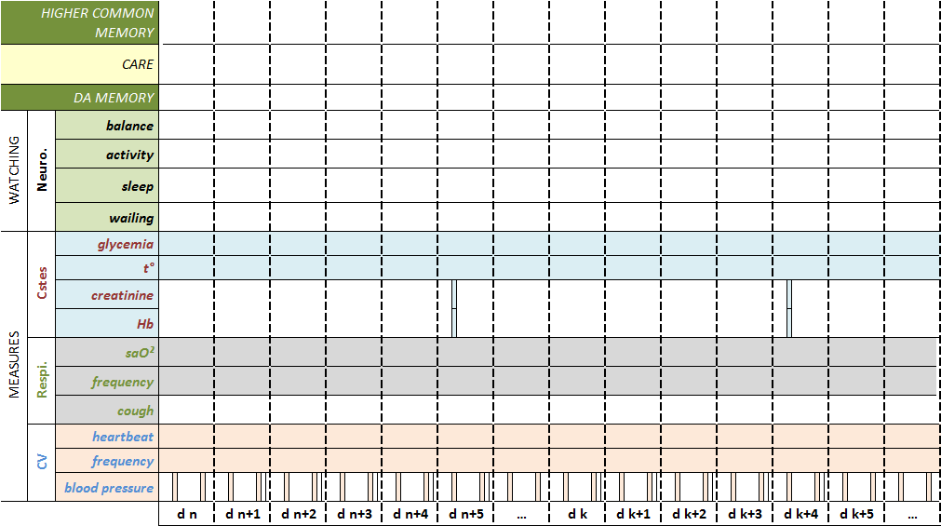
LEARNING A PROCEDURE TO REDUCE AN EPIDEMIC
DISCRETE EVENTS
CONTINUOUS MEASURES
DISCRETE MEASURES
CONTINUOUS MEASURES
DISCRETE EVENTS
CONTINUOUS MEASURES

Slide 35
LEARNING A PROCEDURE TO REDUCE AN EPIDEMIC
5 days
3 days
2.5 days
1 day
C1
C1
C1

Slide 36
Conclusion
The MES methodology studies multi-level systems with a hierarchy of components varying over time and whose dynamics is internally modulated by a network of co-regulator agents. It characterizes the property (MP) at the basis of the formation of increasingly complex objects with emergent properties. In our geriatric application, it is used to develop 'deep learning' through interactions between the medical team and a multi-level Data Analyser, leading to higher procedures for preventing both individual and collective (e.g. epidemic) risks.
In MES the categorical constructions (e.g. complexification) have to be co-ordinated with the dynamics of the elements' attributes, and this makes computations more difficult.
In engineering models, computations are facilitated by working inside a large category W, e.g. Sets (Spivak, 2011) or a large topos like Algos (Graves, 2013). This can be done in MES by supposing that the configuration categories are sub-categories of W and that the complexification is done inside W. However this limits the domain of applications.

Slide 37
References
Ehresmann &. Vanbremeersch, Memory Evolutive Systems: Hierarchy, Emergence, Cognition, Elsevier, 2007.
Ehresmann, MENS, an Info-Computational Model for (Neuro-)cognitive Systems Capable of Creativity, Entropy 14 (12): 1703–16, 2012.
Ehresmann & Simeonov, WLIMES, In: Simeonov, Smith & Ehresmann (Eds.), Integral Biomathics: Tracing the Road to Reality. Springer, 2012.
Ehresmann & Gomez-Ramirez, Conciliating Neuroscience and Phenomen-ology via Category Theory, JPBMB Vol. 19, Issue 2, 2015.
Ehresmann & Béjean, D-MES: conceptualizing the working designers, International J. of Design Management and Prof. Practice, 9-4, 2015.
Ehresmann, Tuomi, Miller, Béjean & Vanbremeersch, Chapter 3, In: R. Miller (Ed.), Transforming the Future: Anticipation in the 21st Century, UNESCO and Routledge, 2017.
Other articles and slides on MES can be found on the sites:
http://ehres.pagesperso-orange.fr
http://vbm-ehr.pagesperso-orange.fr
THANKS.

